Slide 1

Rising 6th Grade Parent Presentation

Slide 2

Counseling Department
Dani Rossi: 6th Grade Counselor
Danielle Wiest: 7th Grade Counselor
Todd Huber: 8th Grade Counselor
Julie Lindley: Counseling Secretary

Slide 3
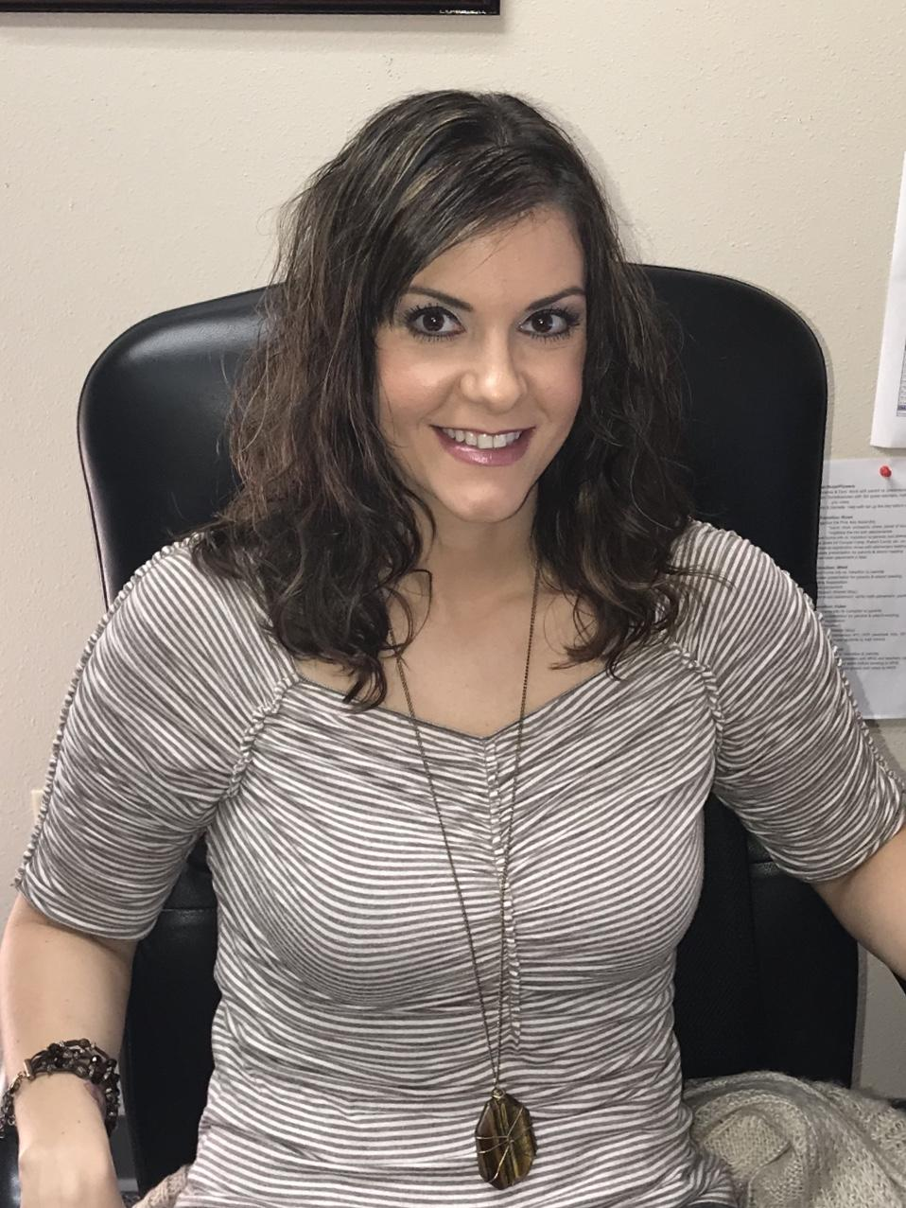


Dani Rossi
6th Grade Counselor
Years in Education: 14
Years in Eanes: 1
Colleges Attended:
University of Texas
  B.S. Education
University of North Texas
  M.Ed. Counseling

Slide 4
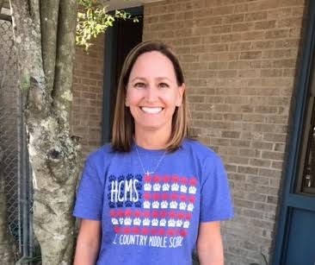


Danielle Wiest
7th Grade Counselor
Years in Education: 22
Years in Eanes ISD: 14
Colleges Attended:
Oklahoma State University
  B.S. Elementary Education
  University of North Texas
  M.S. Counseling

Slide 5
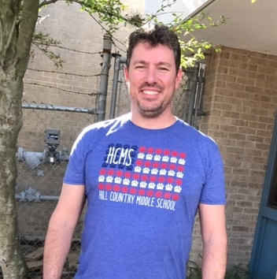


Todd Huber
8th Grade Counselor
Years in Education: 13
Years in Eanes: 4
Colleges Attended:
University of Illinois
  B.S. Psychology
Governors State University
  M.A. Counseling

Slide 6
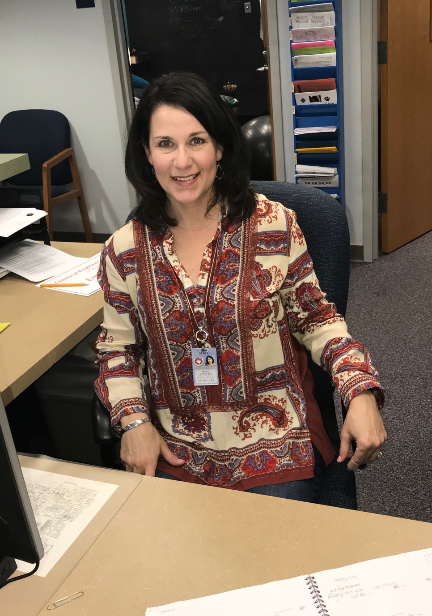
Julie Lindley
Counseling Secretary
Years at Eanes: 5
Colleges Attended:
University of Texas
Journalism

Slide 7

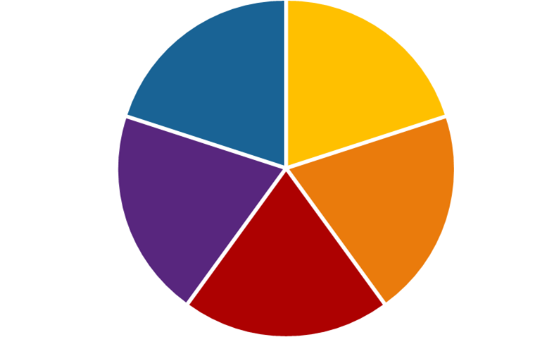
How can students see us?
Come by before
or after school
Send an
email
Come by during lunch or advisory
Fill out
request
form
We
LOVE working with students!

Slide 8


How can we help?
Academic
Support
Advocate
Individual Counseling
Classroom Guidance
Social Emotional Development

Slide 9


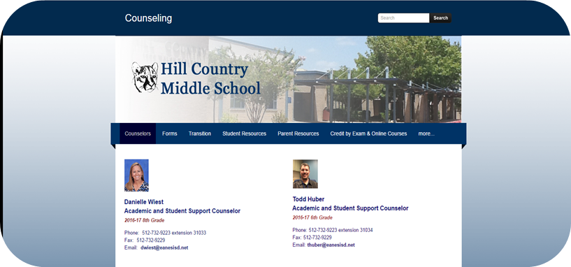
Online Resources

Slide 10



Resources

Slide 11

6TH GRADE ONLINE REGISTRATION
2018-2019

Slide 12
REGISTRATION DATES
February 12th : CCE
February 14th : BPE
February 16th: EE

Slide 13
ONLINE REGISTRATION
Students will register online using Skyward Student Access using the login and password we give them.
After your child registers, you can ask him/her to login and show you the classes they selected.
Changes can be made until February 23rd .
Parents cannot see or make changes to students course selections using Skyward Family Access.
Students are more than welcome to change their passwords once they have registered for classes. We encourage all of our students to use their Skyward Student Access to monitor their grades.

Slide 14

REQUIRED COURSES
English Language Arts or English Language Arts Pre-AP
English Language Arts is open-enrollment. If you are unsure about what is best for your child, you might check with your child’s current ELA teacher.
Science 6
Social Studies or Social Studies GT
  If students are in GT, they need to sign up for Social Studies GT.
Advisory
P.E.
Wheel (Art, Drama, Computer Technology)
Band, Choir or Orchestra

Slide 15

MATH
Students will not select their math class during registration. Math placement will be determined by his/her fifth grade math teacher. You will be notified by the fifth grade math teacher on math placement for 6th grade. Placement letters will be mailed to you in May.
Once we receive the recommendations from the math teachers, we will add the correct math class to his/her schedule.

Slide 16

Math Course Selection for 6th grade
Students enrolled in Math 5 will be placed in Math 6 or Math 6/7 for sixth grade. Students who meet high standards on 5th grade math STAAR and summative assessment, as well as receive a satisfactory grade without Tier II or Tier III math support, are eligible to consider Math 6/7 as an option.
Students enrolling in Math 6/7 must maintain an 80% average or higher on all assessments.
Students enrolled in Math 5/6 will be placed in Math 7 Pre-AP for sixth grade.

Slide 17

What are Credit by Exams?
Credit by Exam provides an additional acceleration option for the very small number of students who are ready to "place out" of a math course.
Historically, less than 10% of Eanes ISD students qualify for math acceleration each year.
These alternative methods do not provide the foundations and depth of instruction that a full year course taken at Hill Country Middle School would provide.
Please note that a CBE may not prepare students for the rigor and expectations for future courses taken in Eanes ISD.

Slide 18

Credit by Exam Options for Mathematics
All students enrolled in Math 5/6 will be provided an opportunity to take a math assessment to “place out” of Math 7.
This assessment will be given at the elementary campus in May. Students will have two hours to complete the assessment (without a calculator) and must score an 80% or higher to be placed into Math 8 Pre-AP.

Slide 19
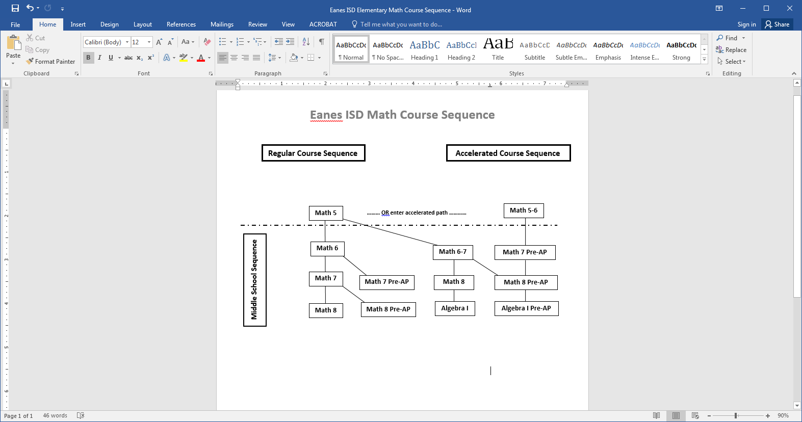

Slide 20
More Math Information
Accelerated Math Course Options
Math Course Sequence
Credit by Exam
Pre-Advanced Placement/Pre-AP
Parent Math Site
EISD Math Information

Slide 21


ELECTIVE INFORMATION
Music: Students must choose either band, orchestra or choir.
P.E.: Students have P.E. every day in 6th grade. A P.E. uniform is required and can be purchased through our Booster Club.
Wheel: Students will have art, drama, and computer technology as part of the exploratory wheel. Students will rotate every 12 weeks.

Slide 22
FREQUENTLY ASKED QUESTIONS
Q: What if I disagree with my child’s math placement in May?
A: Please contact your child’s fifth grade math teacher.
Q: My child is dyslexic and needs the Reading Seminar class. What elective would he/she drop?
A: Your child can choose to replace the wheel or the music elective with Reading Seminar. All students are required to take P.E.

Slide 23
FREQUENTLY ASKED QUESTIONS
Q: Are P.E. waivers allowed for 6th grade students?
A: All P.E. waivers must be a Category 1 for 6th grade students (15 hours a week or more in the same sport). Students must be nationally ranked with Principal approval. P.E. Waivers are not guaranteed for 6th graders.
Q: If Pre-AP is too difficult for my child, can he/she drop?
A: Yes! We don’t want your child to be stressed.
Q: Should I purchase two P.E. uniforms for my child?
A: P.E. is every day. It might be a good idea ☺

Slide 24
FREQUENTLY ASKED QUESTIONS
Q: If my child is taking Math 8 Pre-AP, will he/she be in class with 7th and 8th graders? Will this impact his/her lunch?
A: Yes, but it will not impact their lunch. All 6th graders will have A-lunch.
Q: If my child does not like band or orchestra, can they drop the class?
A: No. Once they have started the class, they are expected to finish the year. Our music classes are a year commitment.
Q: When will my child get his/her iPad?
A: All students will be issued iPads at the beginning of the year. They will take them home and bring them back each day.

Slide 25
FREQUENTLY ASKED QUESTIONS
Q: What will be covered in the Computer Technology class?
A: The curriculum will be PC & iPad based and include digital citizenship.
Q: Can my sixth grader participate in HCMS sports?
A: No. School sports start in the 7th grade.
Q: How are GT services provided at the middle school?
A: Our students receive GT services through their history classes. They receive GT one day each week during history.

Slide 26
FREQUENTLY ASKED QUESTIONS
Q: If my child signs up for a music class (Band, Orchestra, or Choir) and changes his/her mind over the summer, what should I do?
A: Email me, Dani Rossi, drossi@eanesisd.net, and I will make that change for you. I will be your child’s counselor for the next 3 years ☺
Q: How do I sign my child up for Cougar Camp?
A: Cougar Camp will be on August 9th. We will have a morning and afternoon session. Parents will receive an email in May with a link to sign up for a session. Cougar Camp is our 6th grade orientation.

Slide 27
WHAT CLASSES WILL YOUR CHILD REGISTER FOR NEXT WEEK?
Advisory
English or English Pre-AP
Science 6
Social Studies or Social Studies GT
P.E.
Wheel
Band, Choir, or Orchestra
Registration closes February 23rd !

Slide 28
IMPORTANT INFORMATION
HTTP://HCMS.EANESISD.NET/

Slide 29
What you can do
Your support matters!

Slide 30
What can parents do now to help prepare their child(ren) for middle school?
Allow your child to make mistakes at home & school. Failure is an opportunity to learn and grow.
Teach your child how to be organized. They will have 8 classes every day.
Encourage your child to extend his/her friendship circle. Friendships change throughout middle school.
Encourage autonomy at home! We encourage students to advocate for themselves.
Give your child the opportunity to problem solve on their own.
Provide opportunities for your child to make decisions (even if they are not the decision you would make) ☺

Slide 31

School & Studying
Start with the teacher
  Set up a meeting
  You + student
  Goal: self-advocacy
  Ask questions
  Teacher observations?
  How can I support my student’s learning?
  Suggestions?
Attend tutoring
Environment
  Minimize distractions
Timing
  When to start / break
Strategies
  Start with easiest or hardest
  Deadlines, point value
Organization skills
  Notebooks, folders
  Calendar
Academic concerns
Effective study habits

Slide 32

Importance of sleep
http://www.cbsnews.com/news/stanford-university-program-teaches-teenagers-health-risks-of-sleep-deprivation/
Article from Stanford Medicine calls it an “epidemic”
  Students need 8-10 hrs (get 6)
  Impacts concentration, memory, critical thinking, ability to problem-solve
  Impacts physical health, mood, emotion
  Increases anxiety, depression, suicidal thoughts
CBS This Morning
Sleep deprivation
Notes:
Link is to short, 3-minute video

Slide 33

Social Emotional Learning
A district-wide focus on five core competencies

Slide 34
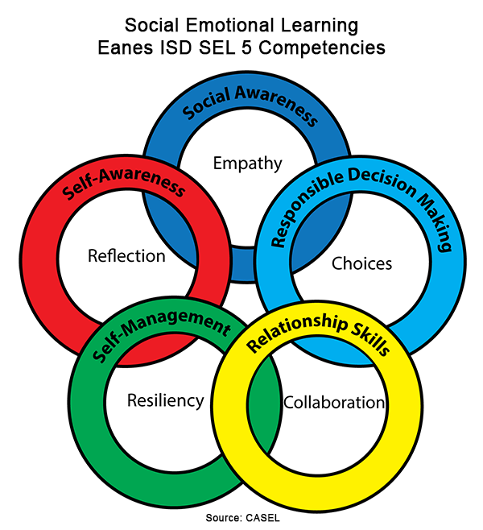

Slide 35
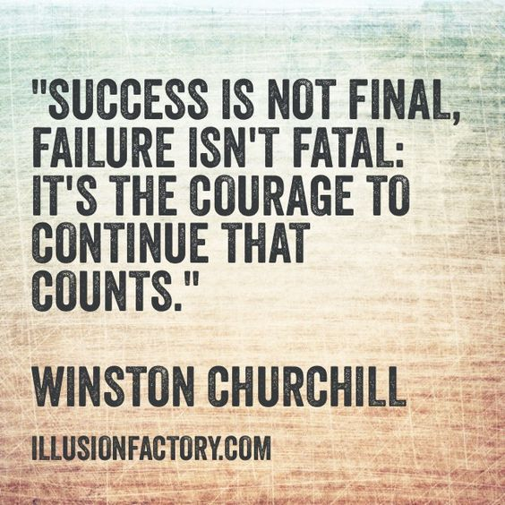
Resiliency + Growth Mindset
School is sometimes hard
Failure IS an option
  The point is to learn from it
  Middle school is a safe place to try
Allow students to experience natural consequences …

Slide 36

Do you … ?
Wake up your teens
Make them breakfast and pack a lunch
Email teachers for missing assignments or absent work
Deliver forgotten lunches, homework, iPads, or projects
Treat teens’ poor planning as an emergency for you
Make decisions or solve problems for your child
Get over-involved with teachers/coaches
Care more about academics/homework than your teen
post from the website For Every Mom

Slide 37


Books for Parents and Educators that can help ☺

Slide 38

Defining Success and
Shaping the Future

Slide 39




How do you define Success?

Slide 40
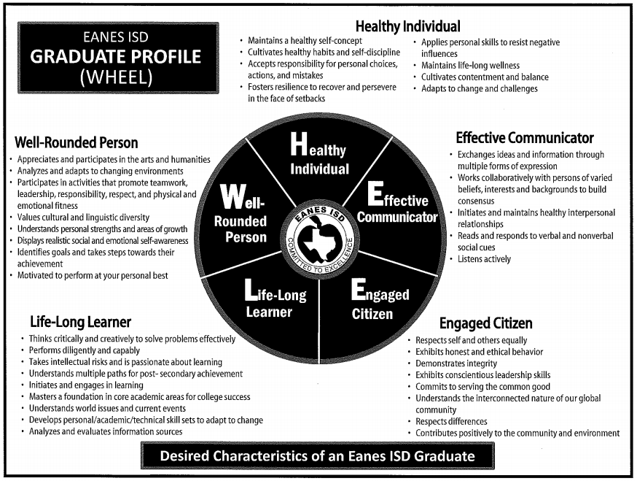
Graduate Profile

Slide 41

Questions?
Thanks for joining us! We are looking forward to a great 2018-2019 school year!

